Slide 1
Electrical Quantities and Circuit Variables
Electrical circuits are described using several basic physical quantities.
These quantities help us to understand how electricity is generated, transferred, controlled, and
used in electrical systems and electronic systems
The main electrical quantities are:
Charge
Current
Voltage
Resistance
Power and
Energy

Slide 2
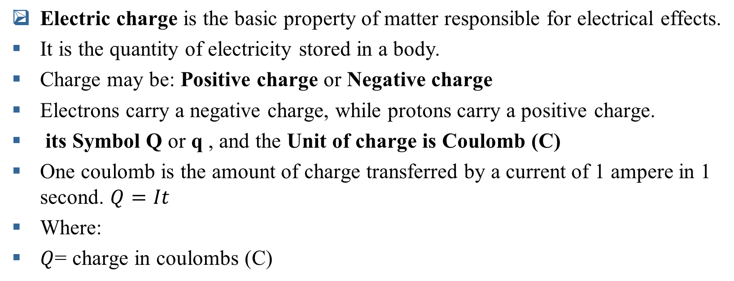
1. Electrical Charge

Slide 3
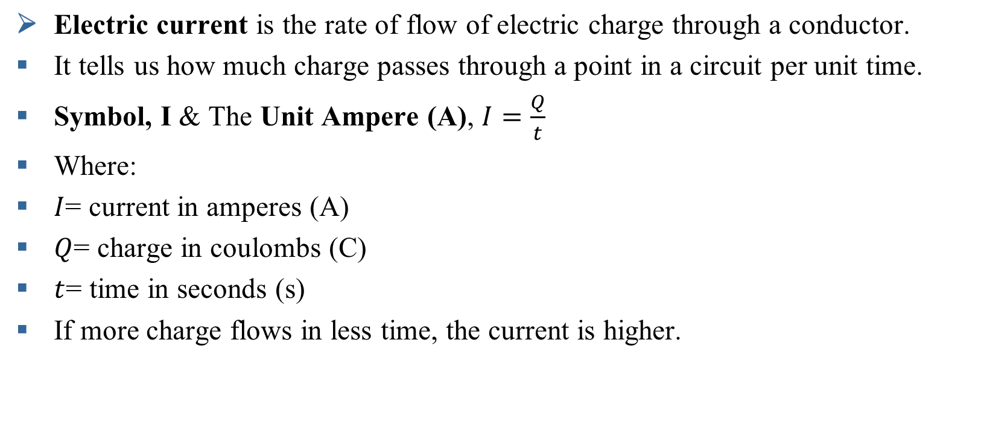
2. Electric Current

Slide 4

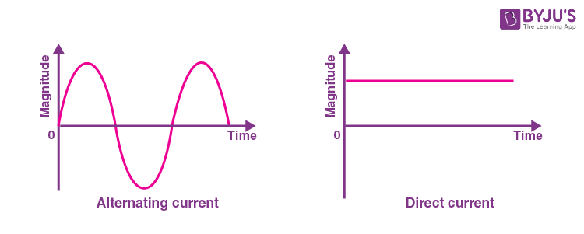
Direct Current (DC)
In DC, the electrons/Charge flow steadily in a single direction. Flows in one direction only.
Alternating Current (AC)
In alternating current, the electric charge flow changes its direction periodically

Slide 5
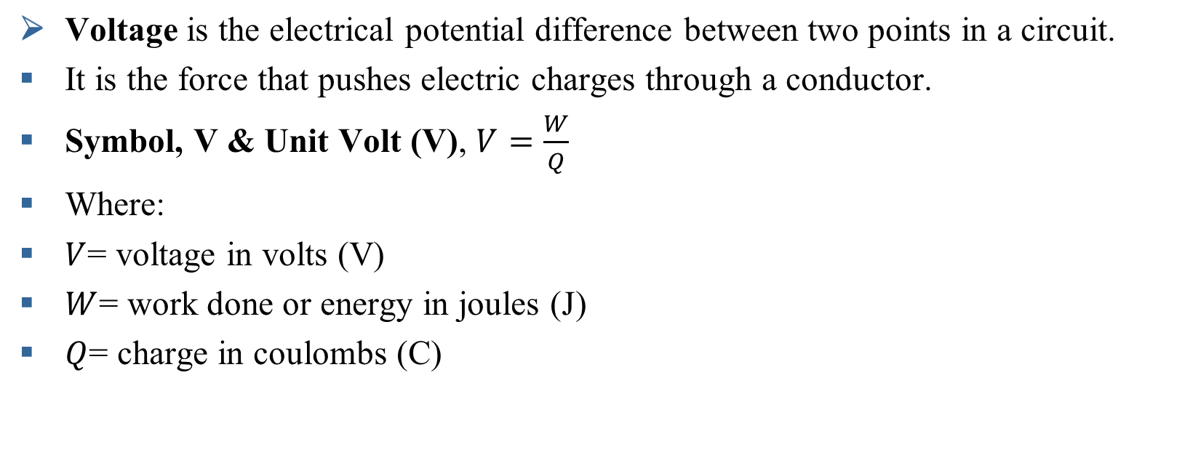
3. Voltage

Slide 6
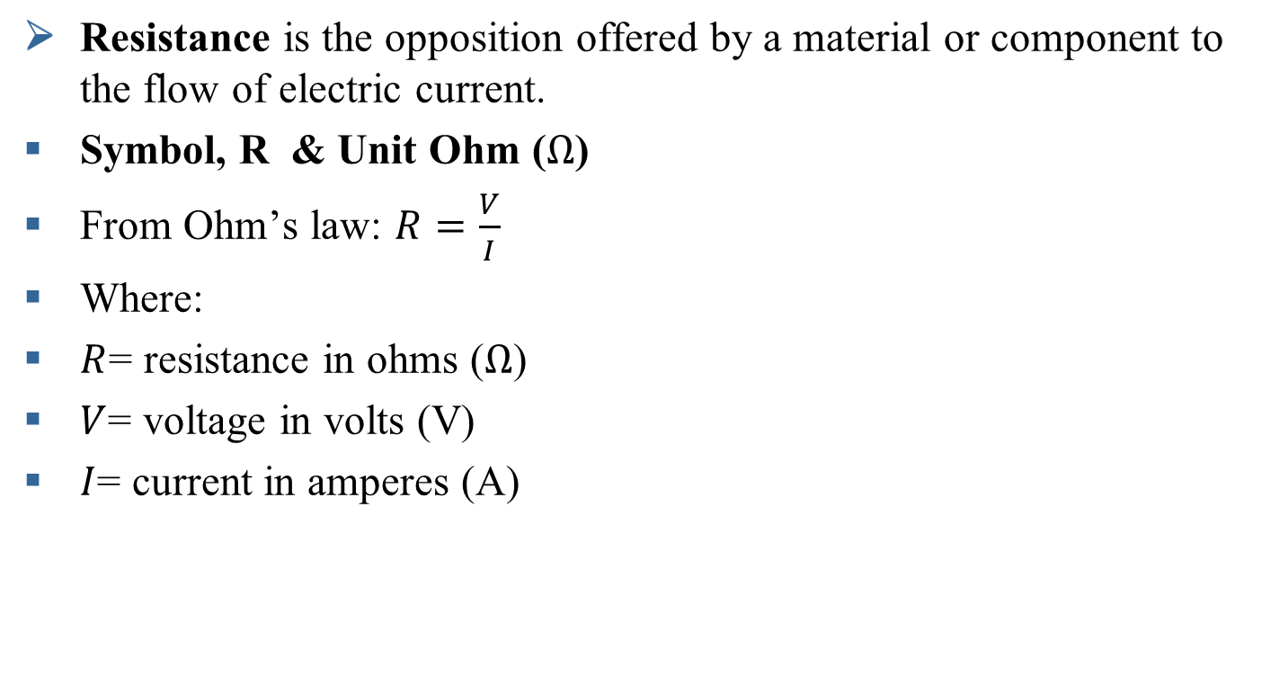
4. Resistance

Slide 7
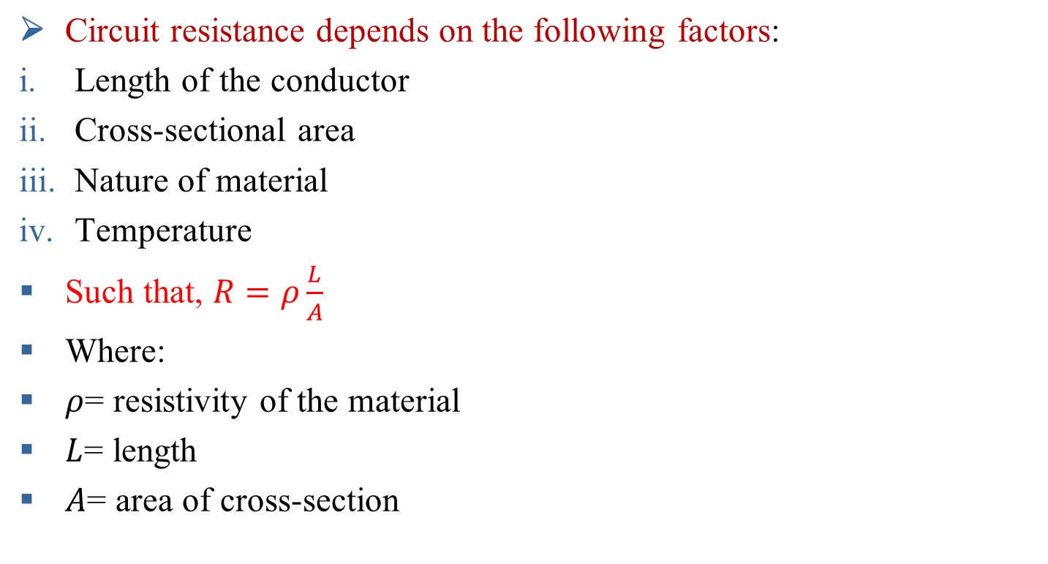
Factors affecting resistance

Slide 8
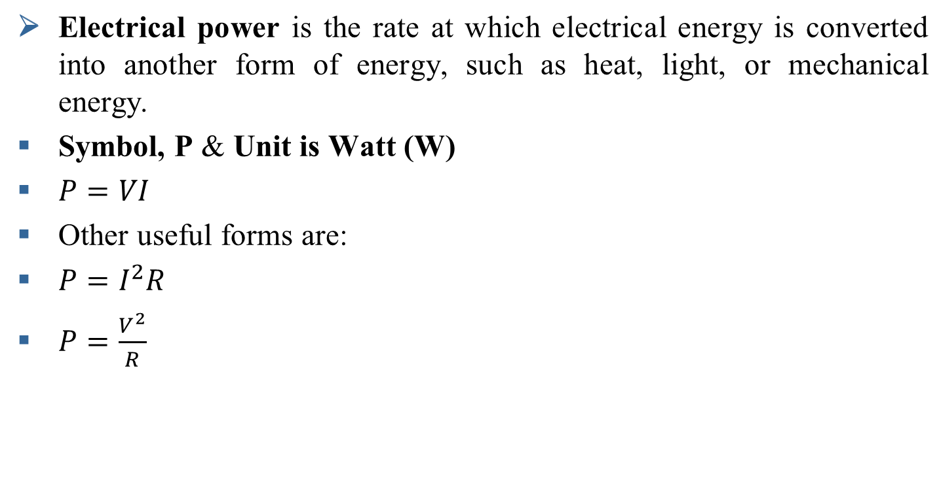
5. Electrical Power

Slide 9
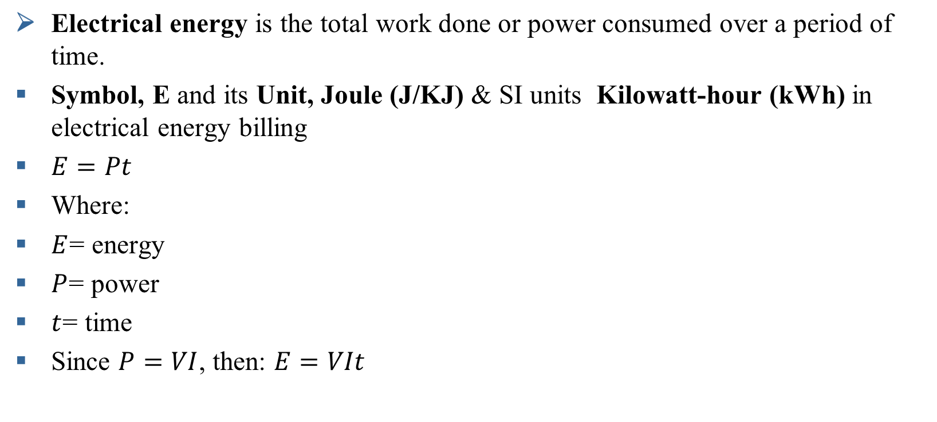
6. Electrical Energy

Slide 10
Worked Example
A resistor is connected to a 24 V supply and draws 4 A for 10 s.
Find:
Resistance
Charge transferred
Power consumed
Energy used

Slide 11

Circuit Analysis
Electrical quantities and circuit variables are fundamental in the analysis of electrical systems/Circuit

Slide 12
Passive and Active Elements in Circuits
Electrical components are broadly classified into:
Passive elements
Active elements
This classification is based on whether the element can supply energy or only consume/store energy.

Slide 13
Cont..
An active component is an electronic component which supplies energy to a circuit.
A passive component is an electronic component which can only receive energy, which it can either dissipate, absorb or store it in an electric field or a magnetic field. Passive elements do not need any form of electrical power to operate

Slide 14
Cont..
Passive Elements Are,
Resistor (R) – opposes current
Capacitor (C) – stores energy in an electric field
Inductor (L) – stores energy in a magnetic field
Active Elements
Voltage sources
Current sources

Slide 15
SERIES AND PARALLEL CIRCUIT

Slide 16
Here’s a brief overview of some primary theorems used in network analysis:
Ohm’s
Kirchhoff’s Laws
Mesh and Nodal analysis techniques
Superposition Theorem
Thevenin’s Theorem
Norton's Theorem
Maximum Power Transfer Theorem
POWER ELECTRONICS-EE6307

Slide 17
These theorems simplify the process of analyzing and solving complex
electrical networks by breaking down circuits into simpler parts.
Familiarity with these theorems allows technicians and engineers to predict
circuit behavior efficiently and accurately.
POWER ELECTRONICS-EE6307

Slide 18
7.Ohm’s Law
Ohm's Law states that the current flowing through a conductor between two points is directly proportional to the voltage across them, provided physical conditions like temperature remain constant. The relationship is defined by the formula, V = IR
Where R is the resistance.

Slide 19
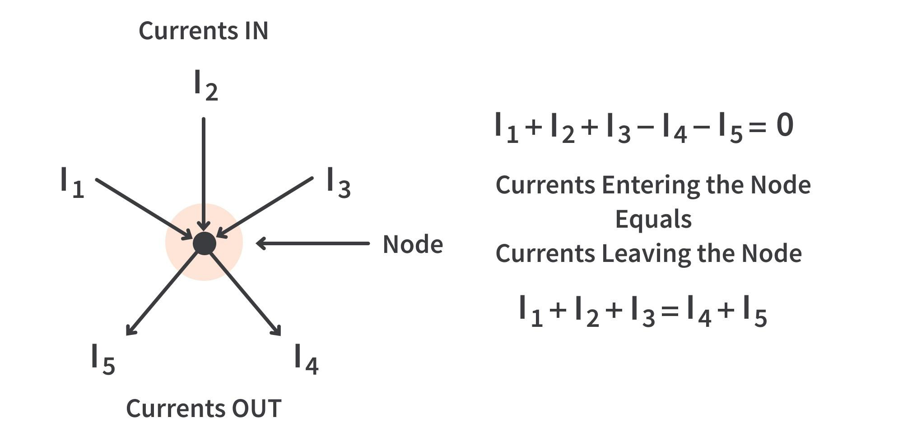
8. Kirchhoff’s Current Law (KCL)
The total current entering a node equals the total current leaving the node.

Slide 20
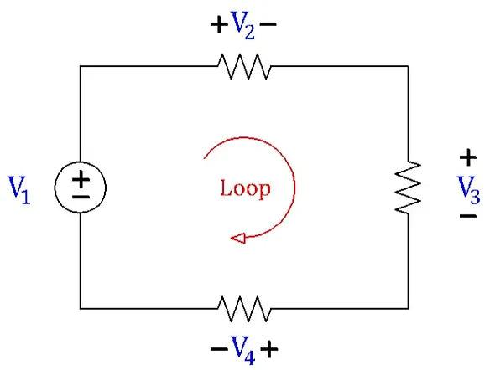
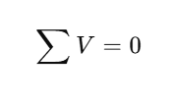
9. Kirchhoff’s Voltage Law (KVL)
The sum of all voltages in a closed loop equals zero.

Slide 21
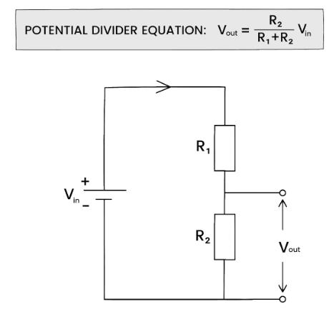
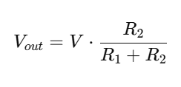
Voltage Divider Rule

Slide 22
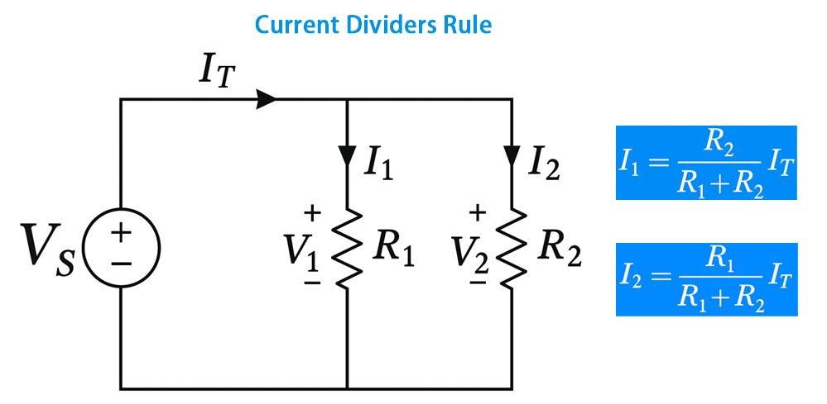
Current Divider Rule

Slide 23
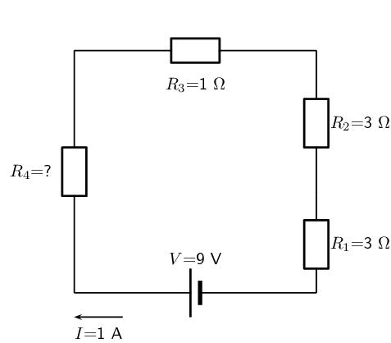
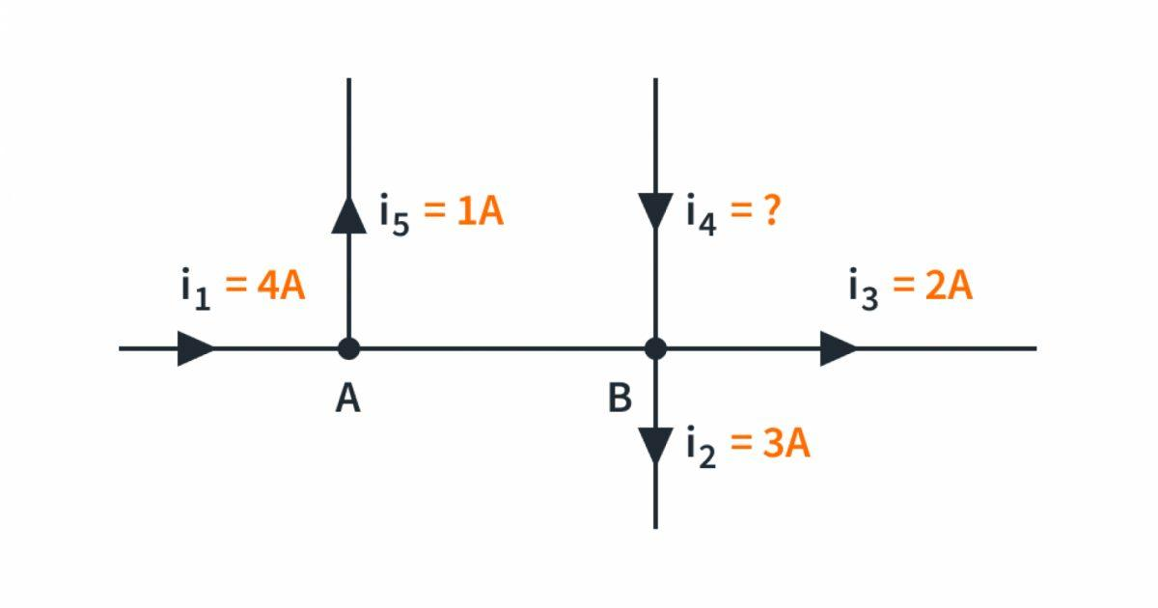
Assignment…………
At a junction, 5 A and 3 A enter, while 4 A leaves.
Find the unknown outgoing current.
What will the Value of R4 and I4…………………………1

Slide 24
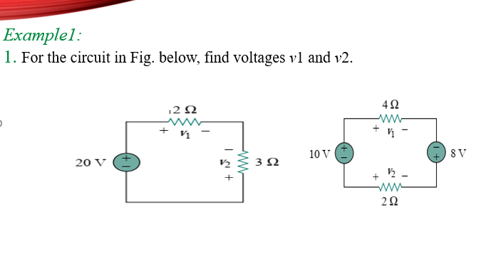

Slide 25
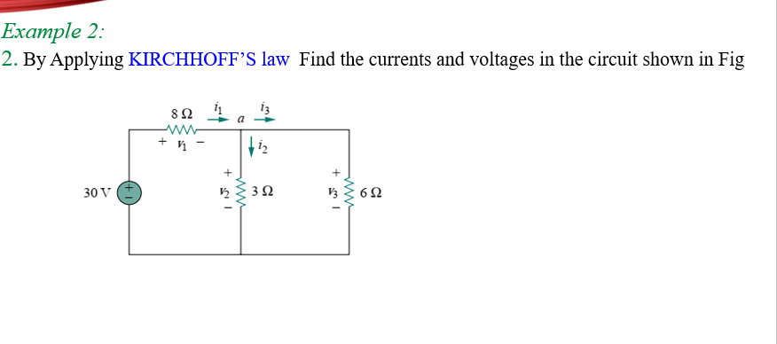

Slide 27
NODAL ANALYSIS
  Nodal analysis provides a general procedure for analyzing circuits using node voltages as the circuit variables.
  Choosing node voltages instead of element voltages as circuit variables is convenient and reduces the number of equations one must solve simultaneously.
  Nodal analysis is also known as the node-voltage method.
  Given a circuit with n nodes without voltage sources, the nodal analysis of the circuit involves taking the following three steps.

Slide 28
NODAL ANALYSIS
  Steps to Determine Node Voltages
  Select a node as the reference node. Assign voltages V₁, V₂………..V_{n-1} to the remaining n-1 nodes. The voltages are referenced with respect to the reference node.
  2. Apply KCL to each of the n-1 non-reference nodes. Use Ohm’s law to express the branch currents in terms of node voltages.
  3. Solve the resulting simultaneous equations to obtain the unknown node voltages.

Slide 29
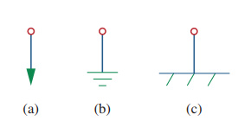
NODAL ANALYSIS
  The reference node is commonly called the ground since it is assumed to have zero potential.
  A reference node is indicated by any of the three below symbols. The type of ground in Fig.(c) is called a chassis ground and is used in devices where the case, enclosure, or chassis acts as a reference point for all circuits

Slide 30
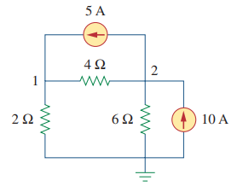
NODAL ANALYSIS
  Example 03: Calculate the node voltages and currents for the given circuit below…………..2

Slide 31
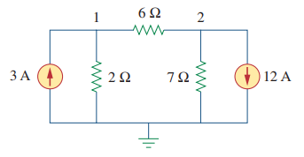
NODAL ANALYSIS
  :Example 4 Calculate the node voltages for the given circuit below………………………………

Slide 32
MESH ANALYSIS
  A loop is a closed path with no node passed more than once.
  A mesh is a loop that does not contain any other loop within it.
  Nodal analysis applies KCL to find unknown voltages in a given circuit, while mesh analysis applies KVL to find unknown currents.
  Mesh analysis is not quite as general as nodal analysis because it is only applicable to a circuit that is planar.

Slide 33
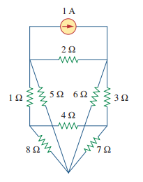
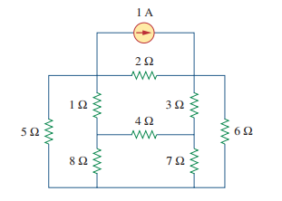
MESH ANALYSIS
  A planar circuit is one that can be drawn in a plane with no branches crossing one another; otherwise it is nonplanar

Slide 34
MESH ANALYSIS
  Steps to Determine Mesh currents
  Assign mesh currents i₁, i₂………..i_{n} to the n meshes.
  Apply KVL to each of the n meshes. Use Ohm’s law to express the voltage in terms of the mesh currents.
  Solve the resulting n simultaneous equations to get the mesh currents

Slide 35
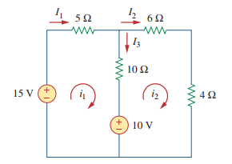
MESH ANALYSIS
  : Example 5; Find the branch currents using mesh analysis

Slide 36
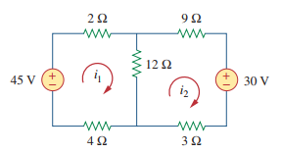
MESH ANALYSIS
  Find the branch currents using mesh analysis……….4

Slide 37
MESH VS NODAL ANALYSIS
  Given a network to be analyzed, how do we know which method is better or more efficient?
  First factor: The nature of the particular network
  Networks that contain many series-connected elements, voltage sources, are more suitable for mesh analysis,
  Whereas networks with parallel-connected elements, current sources, are more suitable for nodal analysis.

Slide 38
MESH VS NODAL ANALYSIS
  Second factor.
  A circuit with fewer nodes than meshes is better analyzed using nodal analysis,
  While a circuit with fewer meshes than nodes is better analyzed using mesh analysis.
  The key is to select the method that results in the smaller number of equations.

Slide 39
MESH VS NODAL ANALYSIS
  Third factor: The information required
  If node voltages are required, it may be expedient to apply nodal analysis.
  If branch or mesh currents are required, it may be better to use mesh analysis

Slide 40
END OF LECTURE 2

